Slide 1


System Analysis And Design (SAD)
Smita Bisht
Assistant Professor
School of Polytechnic

Slide 2
SYSTEM DEVELOPMENT LIFE CYCLE(SDLC)
The system development life cycle is a process by which a software system is developed, tested, installed and maintained. The life cycle contains phases, each of which is a software process.
The development of an information system is a multi-staged process.

Slide 3
In other words we can say that various activities put together are referred as system development life cycle.
SDLC is a process followed for a software project, within a software organization.
It consists of a detailed plan describing how to develop, maintain, replace and alter or enhance specific software.
The systems analyst interacts with users to identify goals, and designs systems to achieve them.

Slide 4
PHASES OF SOFTWARE DEVELOPMENT LIFE CYCLE(SDLC)
System Study.
Feasibility Study.
System Analysis.
System Design.
Development and Testing.
Implementation.
Periodic Evaluation and Maintenance.

Slide 5
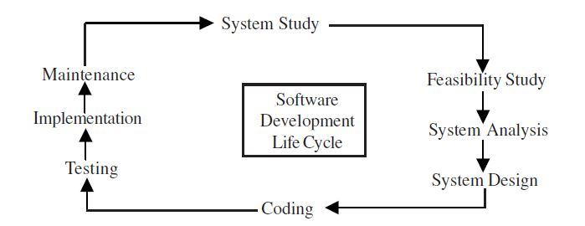

Slide 6
SYSTEM STUDY
System study is the first stage of system development
life cycle.
The initial system study involves the preparation of a
‘System Proposal’ which lists the Problem Definition, Objectives of the Study, Expected benefits of the new system, etc.

Slide 7
Whenever we are going to develop a solution for the problem, it is required that we should know the problem well.
Define project goals and scope.
Study the problem and Propose alternative problem solutions.
System Study : Initial Survey/Initial Investigation.
What is the Problem?

Slide 8
FEASIBILTY STUDY
Feasibility study is conducted on the basis of initial study/investigation of the system. It is the second phase of system development life cycle.
Feasibility study is a test of a system proposal according to its workability, impact on the organization, ability to meet user needs, and effective use of resources.

Slide 9
The main purpose of feasibility study is not to solve the problem but to achieve the scope.
The feasibility study focuses on three main questions:-
1) What are the user’s requirements and how does the system satisfy them?
2) What are the available resources for a given system? Does the problem need to be dealt with? Is it worth solving?
3)How will the system affect the organization? How well does the system fit in the organization’s MIS plan?

Slide 10
SYSTEM ANALYSIS
System Analysis is the third phase of system development life cycle.
Whatever stated in the feasibility study, is presented in this phase in the form of pictures such as E-R diagrams, data flow diagrams etc.
System Analysis is a detailed study of the various functions performed by a system and their relationships within and outside the system.

Slide 11
This phase is also called as “Logical Design”.
System Analysis : What must be done in order to solve the problem?
Analysis specifies the boundaries of the system.
Tools are used and logical models of the system developed.
After the completion of the analysis, the analyst gets the clear picture of what needs to be done.

Slide 12
SYSTEM DESIGN
The analysis phase present the logical view of the system whereas system design phase presents the physical design of the system.
Basically it is a transformation of system analysis.
Design is the most challenging and creative phase of system development.

Slide 13
Some of the questions that usually arise at this stage:
1) How much of the system should be automated with information technology?
2) Should we use readymade software or we should build it from scratch?
3)The System is to be designed for a local area network of the company or a web based solution?
4) How many emerging technologies might be used in the system?

Slide 14
After the code is developed it is tested against the requirements to make sure that the product is actually solving the needs addressed and gathered during the requirements phase.
During this phase all types of functional testing like unit testing, integration testing, system testing, are done as well as non-functional testing are also done.

Slide 15
IMPLEMENTATION
The implementation phase mainly focus on user training, site preparation, and database creation.
When the system is connected to terminals, the telecommunications network and tests of network along with system are also performed.

Slide 16
PERIODIC EVALUATION AND MAINTENANCE
The Evaluation and maintenance of the system starts, once the installation phase gets completed.
Once when the customers starts using the developed system then the actual problems comes up and needs to be solved from time to time.
This process where the care is taken for the developed product is known as maintenance.

Slide 17
